Slide 1



Fırat Olçum
7 May 2023

Slide 2

Outline
Executive Summary
Introduction
Methodology
Results
Conclusion
Appendix

Slide 3
Executive Summary
Summary of methodologies
Data collection
Data wrangling
Exploratory Data Analysis with Data Visualization
Exploratory Data Analysis with SQL
Building an interactive map with Folium
Building a Dashboard with Plotly Dash
Predictive analysis - Classification
Summary of all results
Exploratory Data Analysis results
Interactive analytics demo in screenshots
Predictive Analysis results

Slide 4
Introduction
Project Background and context
SpaceX is the most successful company of the commercial space age, making space travel affordable. The company advertises Falcon 9 rocket launches on its website, with a cost of 62 million dollar; other providers cost upward of 165 million dollars each, much of the savings is because SpaceX can reuse the first stage. Therefore, if we can determine if the first stage will land, we can determine the cost of a launch.
Based on public information and machine learning models, we are going to predict if SpaceX will reuse the first stage.
Questions to be answered
How do variables such as payload mass, launch site, number of flights, and orbits affect the success of the first stage landing?
Does the rate of successful landings increase over the years?
What is the best algorithm that can be used for binary classification in this case?

Slide 5

Section 1

Slide 6
Methodology
Executive Summary
Data collection methodology:
We will be working with SpaceX launch data that is gathered from an API, specifically the SpaceX REST API.
We will be using the Python BeautifulSoup package to web scrape some HTM tables that contain valuable Falcon 9 launch records.
Perform data wrangling
The data will be stored in lists and will be used to create our dataset. We will filter the data to remove irrelevant data.
We will deal with NULL values in order to make the dataset viable for analysis.
We will be using One Hot Encoding to prepare the data to a binary classification.
Perform exploratory data analysis (EDA) using visualization and SQL
Perform interactive visual analytics using Folium and Plotly Dash
Perform predictive analysis using classification models
We will be building, tuning and evaluating of classification models to ensure the best results.

Slide 7
Data Collection
Data collection process involved a combination of API requests from SpaceX REST API and Web Scraping data from a table in SpaceX’s Wikipedia entry.
We had to use both of these data collection methods in order to get complete information about the launches for a more detailed analysis.
Data Columns are obtained by using SpaceX REST API:
FligthNumber, Date, BoosterVersion, PayloadMass, Orbit, LaunchSite, Outcome, Flights, GridFins, Reused, Legs, LandingPad, Block, Reusedcount, Serial, Longitude, Latitude.
Data Columns are obtained by using Wikipedia Web Scraping:
Flight No., Launch site, Payload, PayloadMass, Orbit, Customer, Launch outcome, Version booster, Booster landing, Date, Time.

Slide 8
Data Collection – SpaceX API
1
2
3
4
Requesting rocket launch
data from SpaceX API.
Decoding the response content using .json() and turning it into a dataframe using .json_normalize().
Requesting needed information about the launches from SpaceX API
by applying custom
functions.
5
Step
Step
Step
Step
Step
Constructing data we have obtained into a dictionary.
8
7
6
5
Step
Step
Step
Step
Exporting the data to CSV.
Replacing missing values of Payload Mass column with calculated .mean() for this column.
Filtering the dataframe to only include Falcon 9 launches.
Creating a dataframe from the dictionary.
Click to see Jupyter Notebook about Data Collection API

Slide 9
Data Collection – Scraping
1
2
3
4
Requesting Falcon 9 launch data from Wikipedia.
Creating a BeautifulSoup object from the HTML response.
Extracting all column
names from the HTML
table header.
5
Step
Step
Step
Step
Step
Collecting the data by parsing HTML tables.
7
6
5
Step
Step
Step
Exporting data to CSV.
Creating a dataframe from the dictionary.
Constructing data we have obtained into a dictionary.
Click to see Jupyter Notebook about Web Scraping

Slide 10
Data Wrangling
1
2
3
4
5
6
Perform exploratory
data analysis and determine training labels.
Calculate the number
of launches on each
site.
Calculate the number and occurrence of
each orbit.
Calculate the number
and occurrence of
mission outcome per
orbit type.
Create a landing
outcome label from Outcome column.
Exporting the data to CSV.
Step
Step
Step
Step
Step
Step
In the dataset, there are different cases where the booster land or did not land successfully:
True Ocean means that the mission outcome was successfully landed to a specific region of the ocean, while False Ocean means the opposite.
True RTLS means that the mission outcome was successfully landed to a ground pad, while False RTLS means the opposite.
True ASDS means that the mission outcome was successfully landed on a drone ship, while False ASDS means the opposite.
We mainly convert those outcomes into training labels with “1” means the booster successfully landed, “0” means it was unsuccessful.
Click to see Jupyter Notebook about Data Wrangling

Slide 11
EDA with Data Visualization
Charts were plotted:
Flight Number vs. Payload Mass, Flight Number vs. Launch Site, Payload Mass vs. Launch Site, Orbit Type vs. Success Rate, Flight Number vs. Orbit Type, Payload Mass vs Orbit Type and Success Rate Yearly Trend.
Scatter plots show the relationship between variables. If a relationship exists, they could be used in machine learning model.
Bar charts show comparisons among discrete categories. The goal is to show the relationships between the specific categories being compared and a measured value.
Line charts show trends in data over time.
Click to see Jupyter Notebook about EDA with Data Visualization

Slide 12
EDA with SQL
Performed SQL queries:
Displaying the names of the unique launch sites in the space mission.
Displaying 5 records where launch sites begin with the string ‘CCA’
Displaying the total payload mass carried by boosters launched by NASA (CRS).
Displaying the average payload mass carried by booster version F9 v1.1.
Listing the date when the first successful landing outcome in ground pad was achieved.
Listing the names of the boosters which have success in drone ship and have payload mass greater than 4000 but less than 6000.
Listing the total number of successful and failure mission outcomes.
Listing the names of the booster versions which have carried the maximum payload mass.
Listing the failed landing outcomes in drone ship, their booster versions and launch site names for the months in year 2015.
Ranking the count of landing outcomes between the date 2010-06-04 and 2017-03-20 in descending order.
Click to see Jupyter Notebook about EDA with SQL

Slide 13
Build an Interactive Map with Folium
Markers of all Launch Sites:
Added Marker with Circle, Popup Label and Text Label of NASA Johnson Space Center using its latitude and longitude coordinates as a start location.
Added Markers with Circle, Popup Label and Text Label of all Launch Sites using their latitude and longitude coordinates to show their geographical locations and proximity to Equator and coasts.
Colored Markers of the launch outcomes for each Launch Site:
Added colored Markers of success (Green) and failed (Red) launches using Marker Cluster to identify which launch sites have relatively high success rates.
Distances between a Launch Site to its proximities:
Added colored Lines to show distances between the Launch Site KSC LC-39A (as an example) and its proximities like Railway, Highway, Coastline and Closest City.
Click to see Jupyter Notebook about Interactive Map with Folium

Slide 14
Build a Dashboard with Plotly Dash
Launch Sites Dropdown List:
Added a dropdown list to enable Launch Site selection.
Pie Chart showing Success Launches (All Sites/Certain Site):
Added a pie chart to show the total successful launches count for all sites and the Success vs. Failed counts for the site, if a specific Launch Site was selected.
Slider of Payload Mass Range:
Added a slider to select Payload range.
Scatter Chart of Payload Mass vs. Success Rate for the different Booster Versions:
Added a scatter chart to show the correlation between Payload and Launch Success.
Click to see Jupyter Notebook about Dashboard with Plotly Dash

Slide 15
Predictive Analysis (Classification)
1
2
3
4
Creating a NumPy array
from the column “Class”
in data.
Standardazing the data
with StandartScaler, then fitting and transforming it.
Splitting the data into
training and testing sets
with train_test_split
function.
5
Step
Step
Step
Step
Step
Creating a GridSearchCV object with cv = 10 to find the best parameters.
8
7
6
5
Step
Step
Step
Step
Finding the method
performs best by
examining the
Jaccard_score and
F1_score metrics.
Examining the confusion matrix for all models.
Calculating the accuracy on the test data using the method .score() for all models.
Applying GridSearchCV on LogReg, SVM, Decision Tree and KNN models.
Click to see Jupyter Notebook about Predictive Analysis

Slide 16
Results
Exploratory data analysis results
Interactive analytics demo in screenshots
Predictive analysis results

Slide 17

Section 2

Slide 18
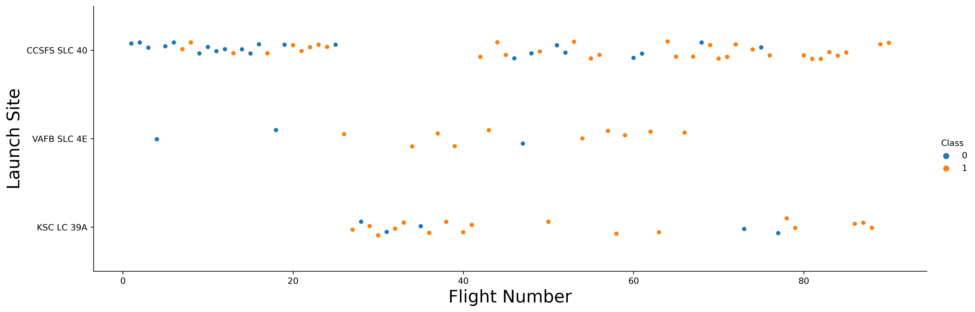
Flight Number vs. Launch Site
Explanation:
The earliest flights all failed while the latest flights all succeeded.
The CCAFS SLC 40 launch site has about a half of all launches.
VAFB SLC 4E and KSC LC 39A have higher success rates.
It can be assumed that each new launch has a higher rate of success.

Slide 19
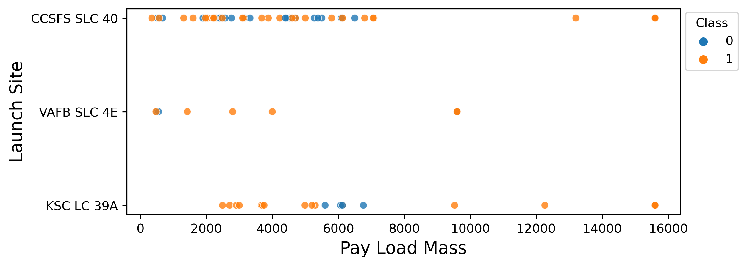
Payload vs. Launch Site
Explanation:
For every launch site the higher the payload mass, the higher the success rate.
Most of the launches with payload mass over 7000 kg were successful.
KSC LC 39A has a 100% success rate for payload mass under 5500 kg too.

Slide 20
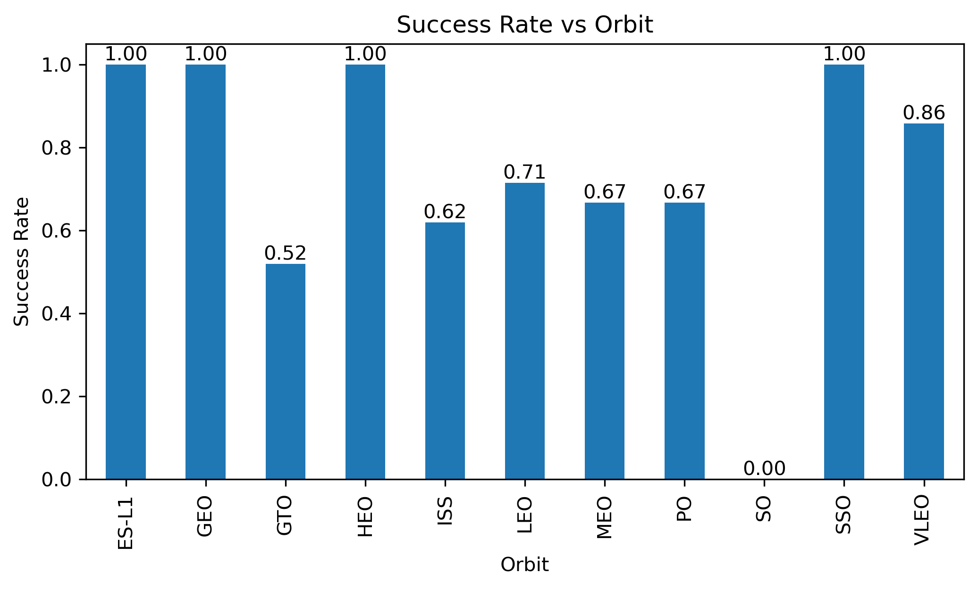
Success Rate vs. Orbit Type
Explanation:
Orbits with 100% success rate : ES-L1, GEO, HEO, SSO
Orbits with success rate between 50% and 85% : GTO, ISS, LEO, MEO, PO
Orbits with 0% success rate : SO

Slide 21
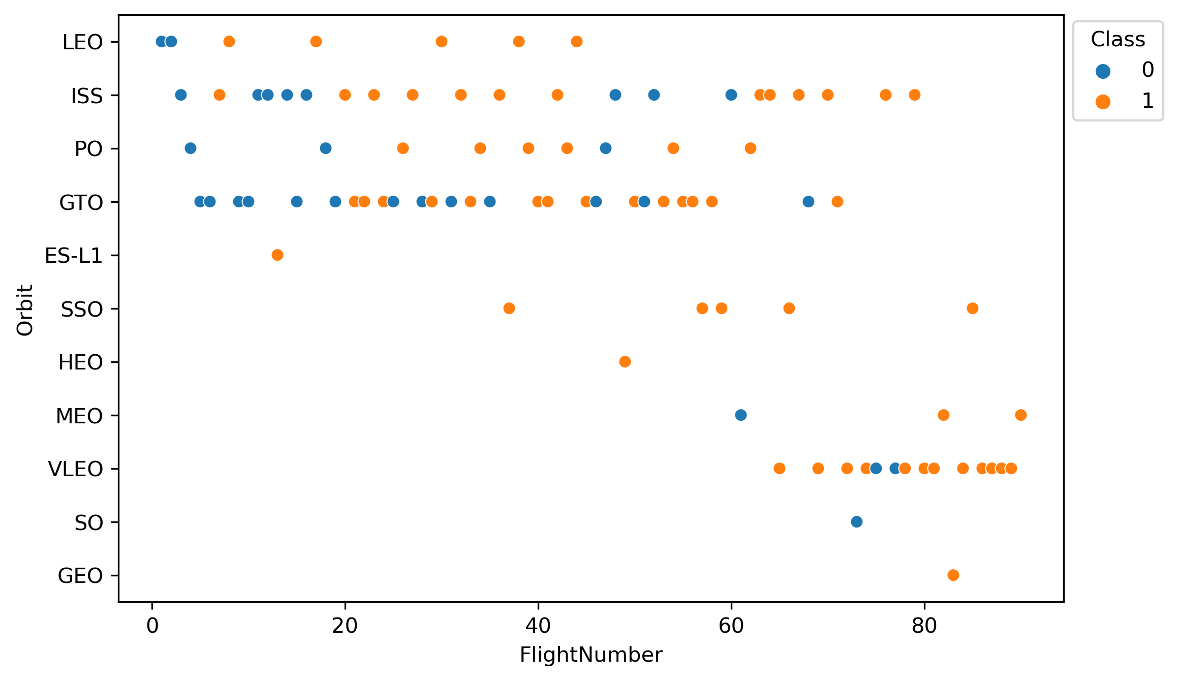
Flight Number vs. Orbit Type
Explanation:
In the LEO orbit the Success appears related to the number of flights; on the other hand, there seems to be no relationship between flight number when in GTO orbit.

Slide 22
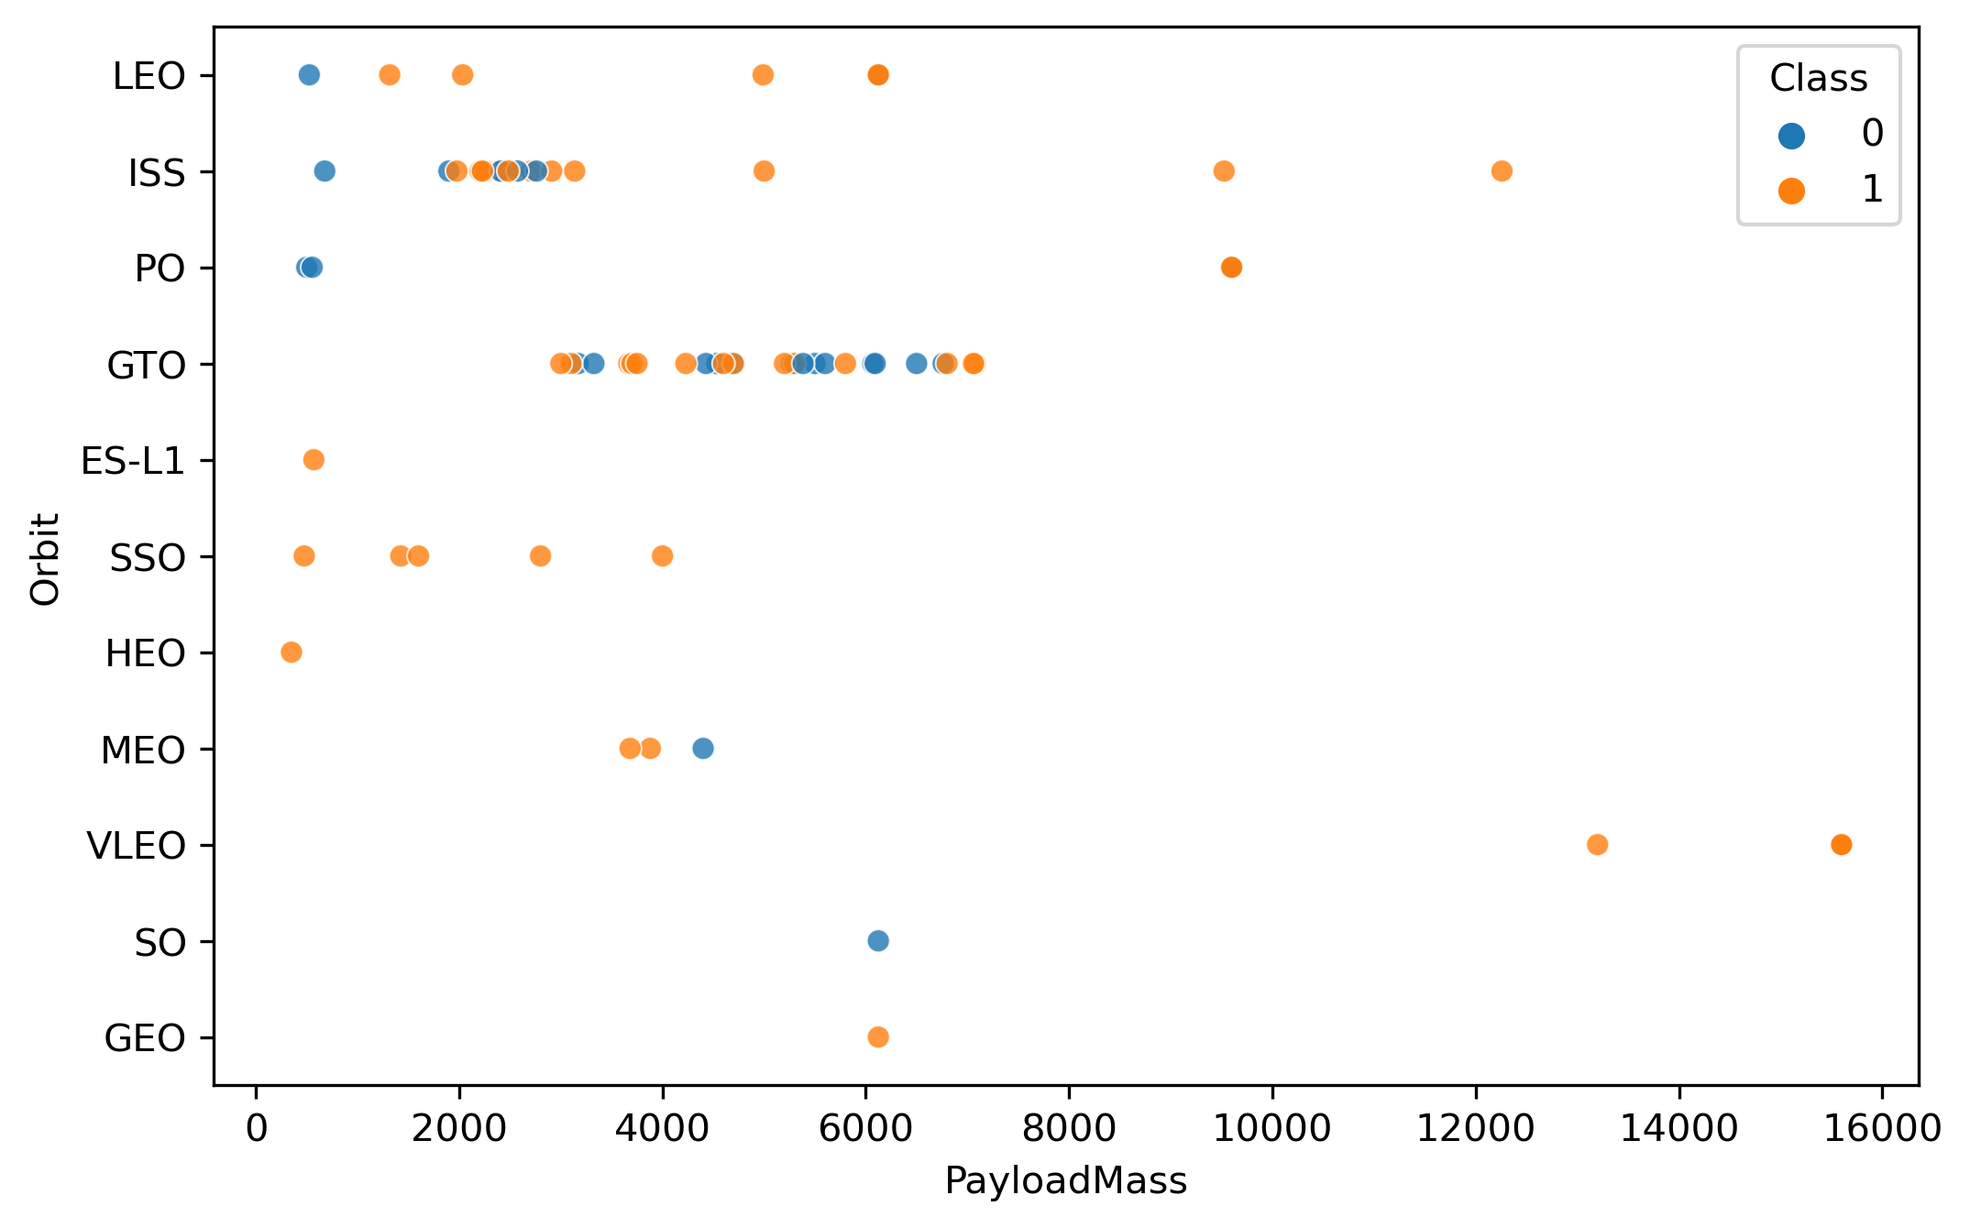
Payload Mass vs. Orbit Type
Explanation:
Heavy payloads have a negative influence on GTO orbits and positive on ISS and LEO orbits.

Slide 23
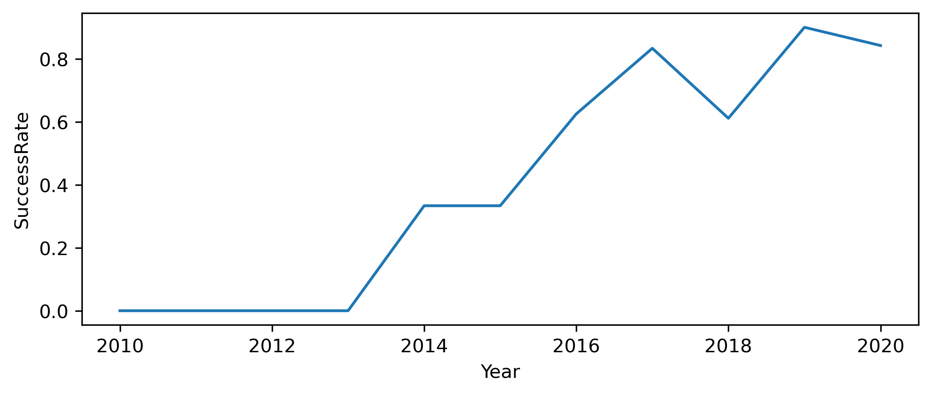
Launch Success Yearly Trend
Explanation:
The success rate since 2013 kept increasing until 2020.

Slide 24
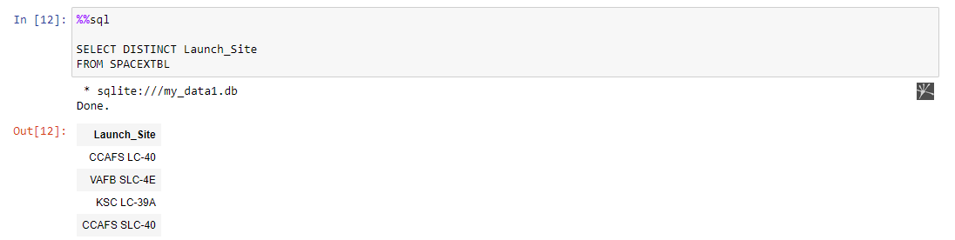
All Launch Site Names
Explanation:
Displaying the names of the unique launch sites in the space mission.

Slide 25
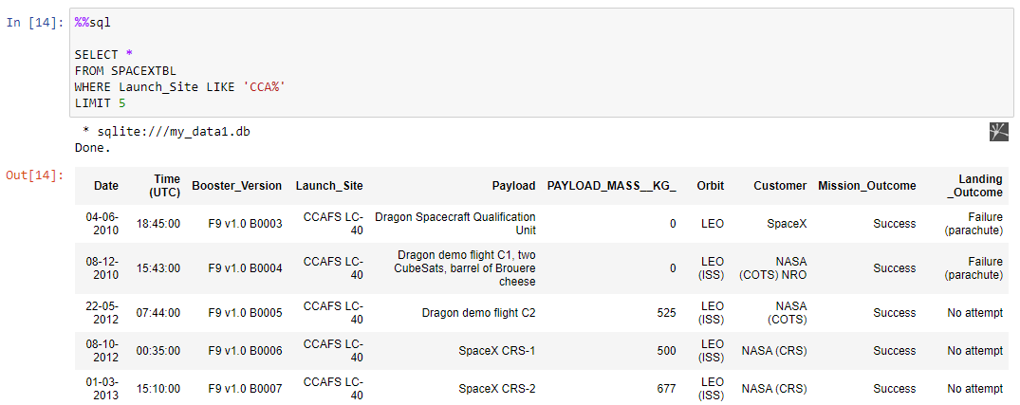
Launch Site Names Begin with 'CCA'
Explanation:
Displaying 5 records where launch sites begin with the string ‘CCA’.

Slide 26
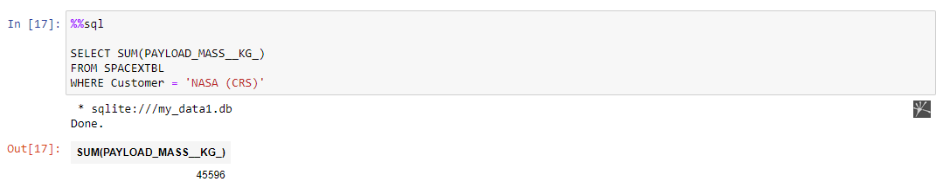
Total Payload Mass
Explanation:
Displaying the total payload mass carried by boosters launched by NASA (CRS).

Slide 27
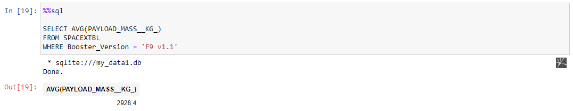
Average Payload Mass by F9 v1.1
Explanation:
Displaying average payload mass carried by booster version F9 v1.1.

Slide 28
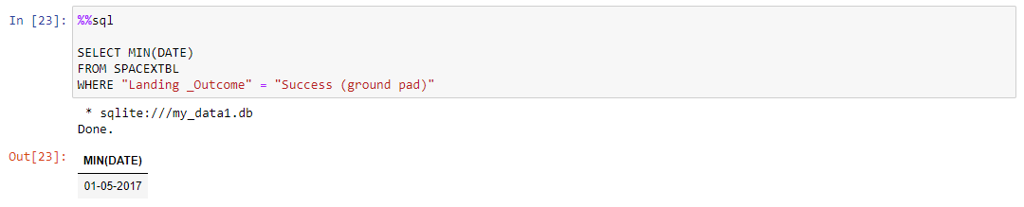
First Successful Ground Landing Date
Explanation:
Listing the date when the first successful landing outcome in ground pad was achieved.

Slide 29
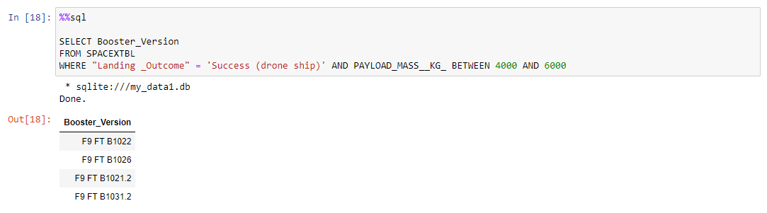
Successful Drone Ship Landing with Payload between 4000 and 6000
Explanation:
Listing the names of the boosters which have success in drone ship and have payload mass greater than 4000 but less than 6000.

Slide 30
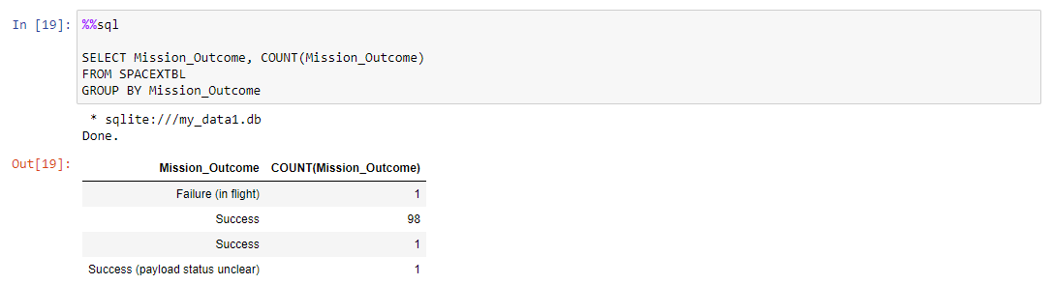
Total Number of Successful and Failure Mission Outcomes
Explanation:
Listing the total number of successful and failure mission outcomes.

Slide 31
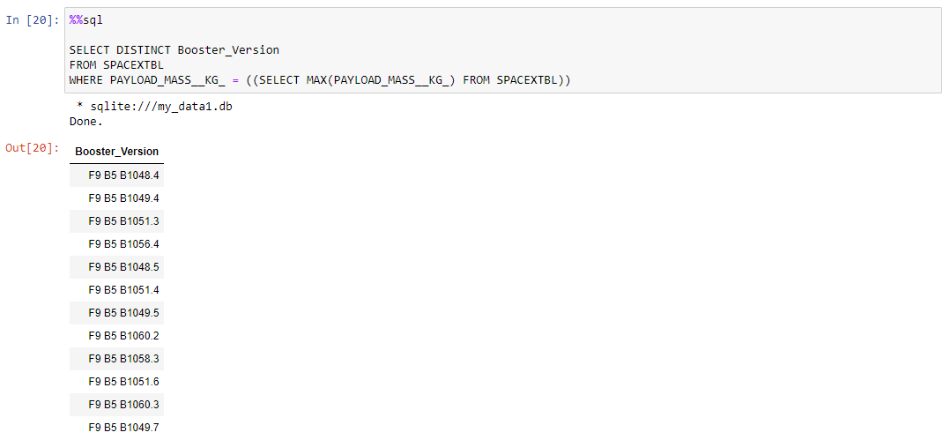
Boosters Carried Maximum Payload
Explanation:
Listing the names of the booster versions which have carried the maximum payload mass.

Slide 32
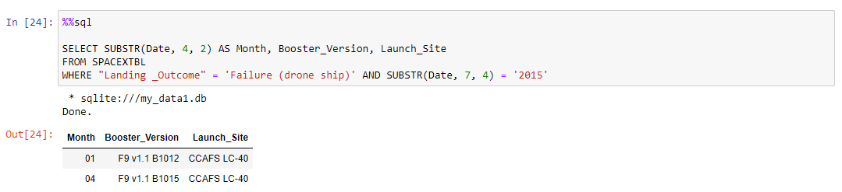
2015 Launch Records
Explanation:
Listing the failed landing outcomes in drone ship, their booster versions and launch site names for the months in year 2015.

Slide 33
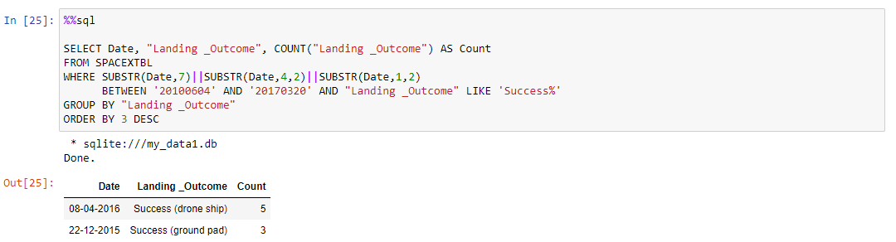
Rank Landing Outcomes Between 2010-06-04 and 2017-03-20
Explanation:
Ranking the count of landing outcomes between the date 2010-06-04 and 2017-03-20 in descending order.

Slide 34

Section 3

Slide 35
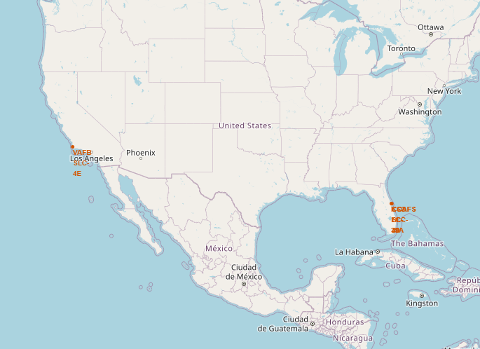
All Launch Sites On a Global Map
Explanation:
Most of the Launch sites are in proximity to the Equator line. The land is moving faster at the equator than any other place on the surface of the Earth. Anything on the surface of the Earth at the equator is already moving at 1670 km/hour.
If a ship is launched from the equator it goes up into space, and it also moving around the Earth at the same speed it was moving before launching. This is because of inertia. The speed will help the spacecraft keep up a good enough speed to stay in orbit.
All launch sites are in very close proximity to the coast, while launching rockets towards the ocean it minimizes the risk of having any debris dropping or exploding near people.

Slide 36
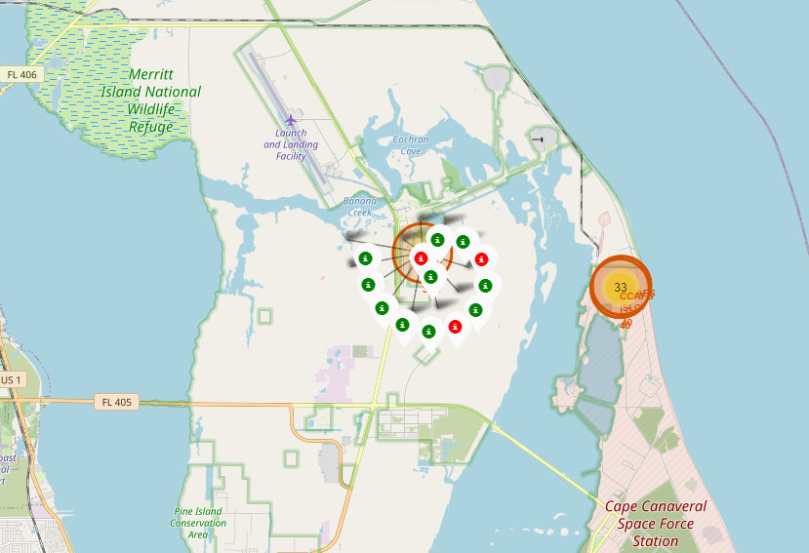
Launch Records on a Global Map
Explanation:
From the color-labeled markers we should be able to easily identify which launch sites have relatively high success rates.
Green Marker : Successful Launch
Red Marker : Failed Launch
Launch site KSC LC-39A has a very high success rate.

Slide 37
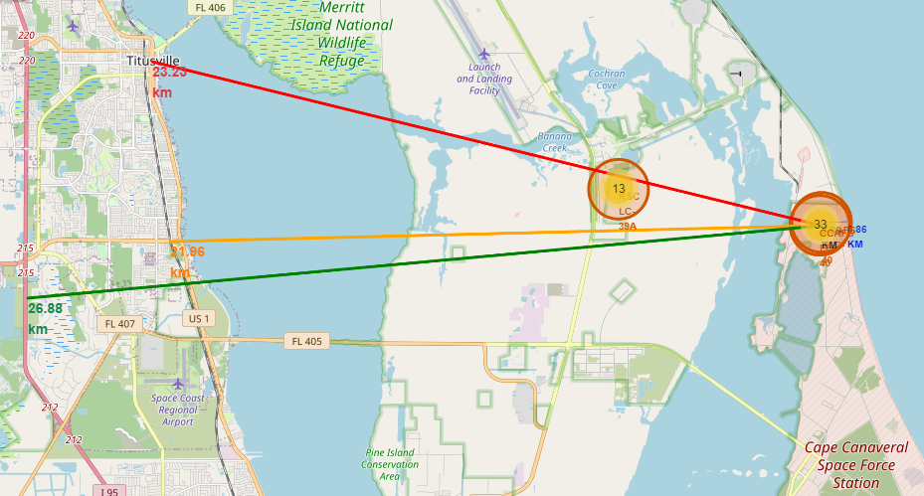
Distance From the Launch Site to Its Proximities
Explanation:
From the visual analysis of the launch site CCAFS LC-40 we can clearly see that it is:
Relatively close to railway : 21.96 km
Relatively close to highway : 26.88 km
Relatively close to coastline : 0.86 km
Also, the launch site CCAFS LC-40 is relatively close to its closest city Titusville : 23.23 km
Failed rocket with its high speed can cover distances like 15-20 km in few seconds. It could be potentially dangerous to populated areas.

Slide 38

Section 4

Slide 39
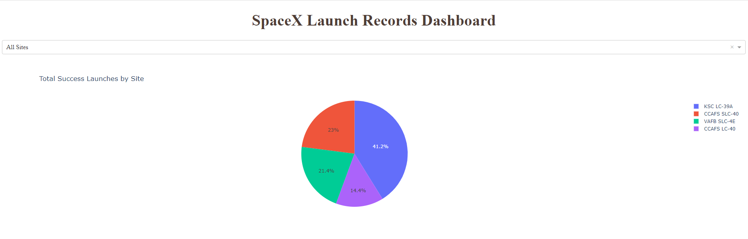
Total Success Launches by Site
Explanation:
The chart clearly shows that from all the sites, KSC LC-39A has the most successful launches.

Slide 40
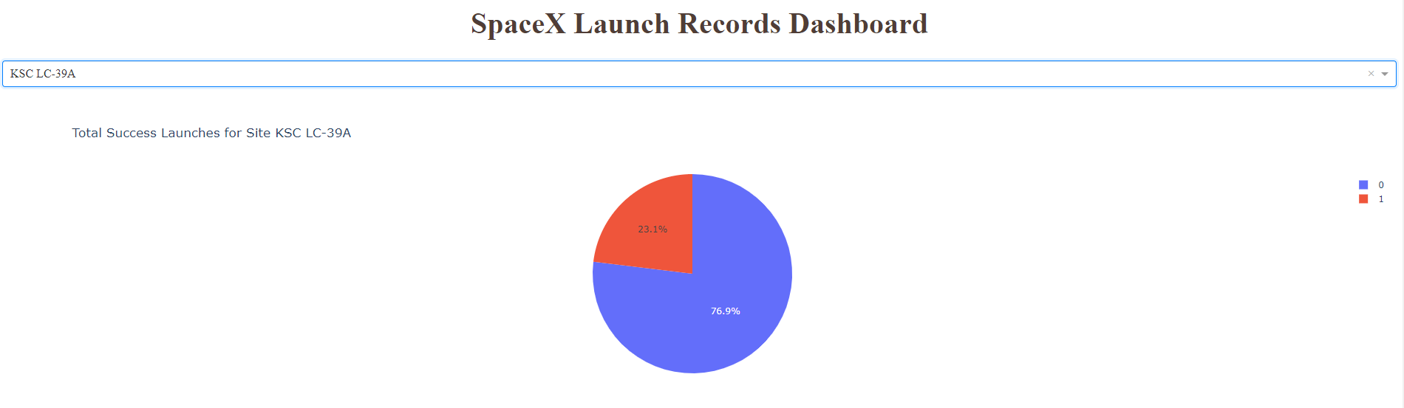
Total Success Launches for Site KSC LC-39A
Explanation:
KSC LC-39A has the highest launch success rate (76.9%) with 10 successful and only 3 failed landings.

Slide 41
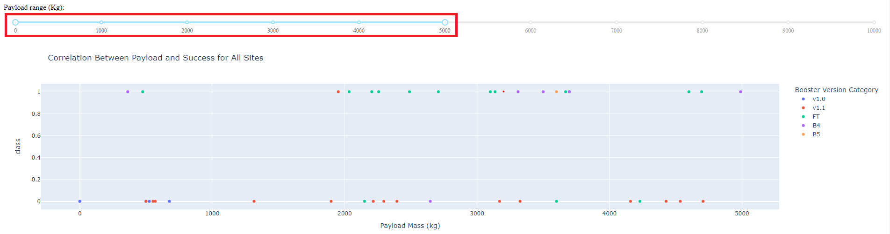
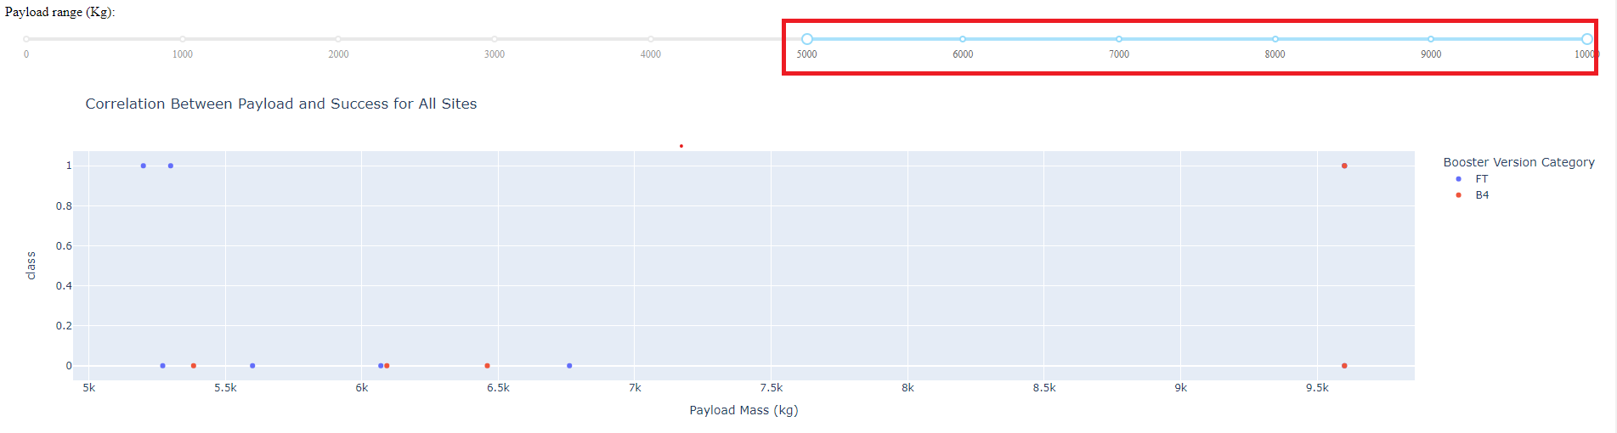
Payload Mass vs. Launch Outcome for All Sites
Explanation:
The charts show that payloads between 2000 and 5500 kg have the highest success rate.

Slide 42

Section 5

Slide 43
Classification Accuracy
Scores and Accuracy of the Test Set
Scores and Accuracy of the Entire Data Set
Explanation:
Based on the scores of the test set we can not confirm which method performs best.
Same test scores may be due to the small test sample size (18 samples). Therefore, we tested all methods based on the whole dataset.
The scores of the whole dataset confirm that the best model is the Decision Tree Model. This model has not only higher scores but also the highest accuracy.

Slide 44
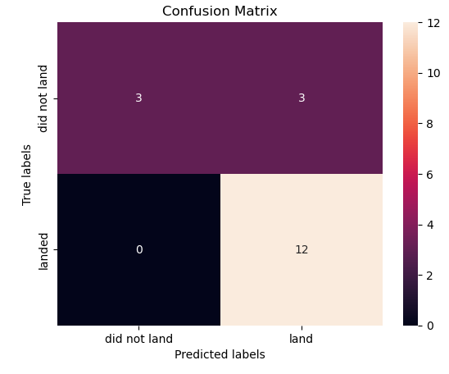
Confusion Matrix
Explanation:
Examining the confusion matrix, we see that Logistic Regression can distinguish between the different classes. We see that the major problem is False Positives.

Slide 45
Conclusions
Decision Tree model is the best algorithm for this dataset.
Launches with a low payload mass show better results than launches with a larger payload mass.
Most of launch sites are in proximity to the Equator line and all the sites are in very close proximity to the coast.
The success rate of launches increases over the years.
KSC LC-39A has the highest success rate of the launches from all the sites.
Orbits ES-L1, GEO, HEO and SSO have 100% success rate.

Slide 46
Appendix
IBM Data Science Professional Certificate consists of 10 courses:
What is Data Science?
Tools for Data Science
Data Science Methodology
Python for Data Science, AI & Development
Python Project for Data Science
Databases and SQL for Data Science with Python
Data Analysis with Python
Data Visualization with Python
Machine Learning with Python
Applied Data Science Capstone

Slide 47


